Slide 1

Starting school in 2026
Update for 2018
1
Notes:
1

Slide 2
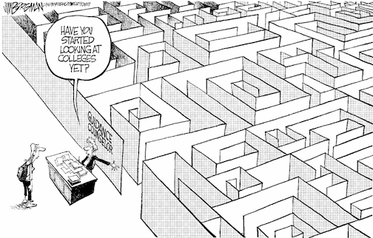
Choosing a school
Have you
started
looking
at schools
yet?

Slide 3
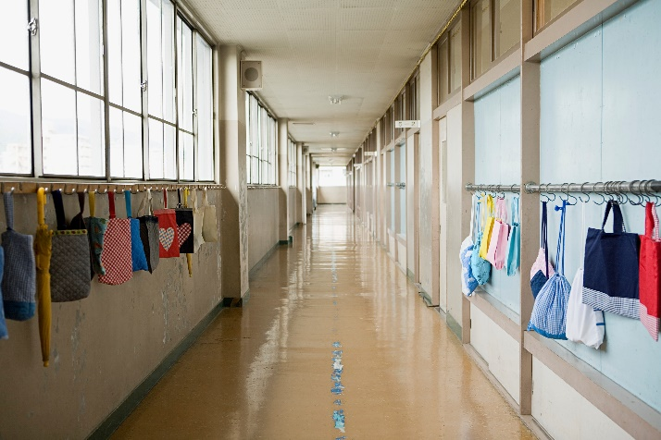
Choosing a school
How do I know which school is right for my child?
Who can help me make that decision?

Slide 4

Choosing a school
Talk to your child
  find out what is best for them
  consider how they will travel to school

Slide 5

Choosing a school
Choosing a school
Visit the schools
  talk to the headteacher & staff
  ask for a tour of the school
  … however, you will need to check the visiting arrangements with individual schools as access may be restricted post-Covid

Slide 6

Choosing a school
Read the school prospectus
  it will have detailed information about:
    how the school is run
    the admissions criteria
  available from the school
  download from the school website

Slide 7
Choosing a school
Read the primary education brochure published by your home local authority
  download Barnet’s booklet at www.barnet.gov.uk/schools-and-education/school-admissions/apply-primary-school/starting-reception-september-2026

Slide 8
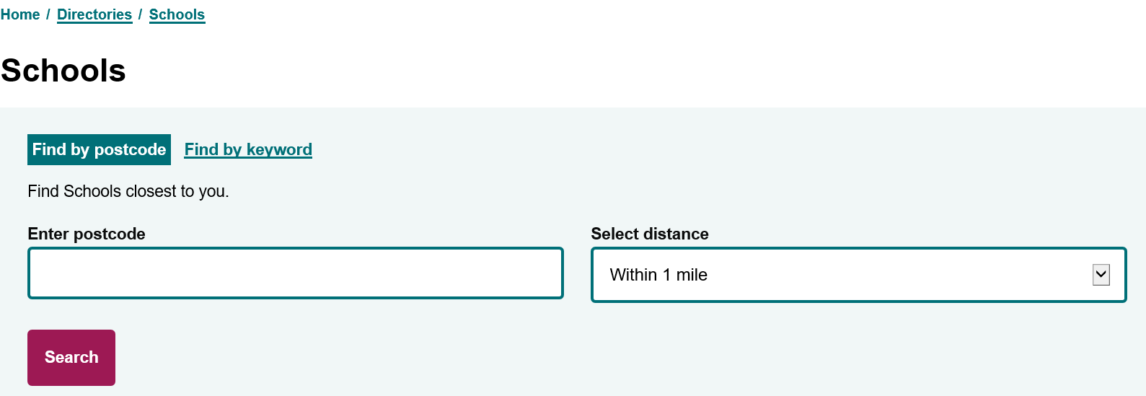
Choosing a school
You can also find details of Barnet primary schools in the Schools Directory at
www.barnet.gov.uk/directories/schools

Slide 9

Choosing a school
Talk to the Customer Contact Centre
  the team can offer you advice and answer your questions
  how do I contact them?
    tel: 020 8359 7651
    if you live outside Barnet, you will find the contact details for your admissions team in Barnet’s primary education booklet

Slide 10


Choosing a school
Look at Performance Tables and Ofsted reports
  the latest Ofsted reports are available from the Ofsted website www.ofsted.gov.uk
  achievement and attainment tables are available at www.gov.uk/school-performance-tables

Slide 11

Choosing a school
Look carefully at the admission criteria for each school
  siblings
  children of staff
  distance

Slide 12
Barnet Community Schools Allocations April 2025
Name of School | Places Available | On-time applications | Siblings | Children living in defined area | Children living outside defined area
 |  |  |  | Furthest straight-line distance offers (miles)
Barnfield Primary | 60 | 162 | 18 | All | 0.951
Brookland Infant | 90 | 234 | 29 | All | All
Brunswick Park Primary | 60 | 163 | 21 | All | All
Chalgrove Primary | 30 | 131 | 13 | All | 1.184
Church Hill Primary | 30 | 101 | 5 | All | All
Colindale Primary | 90 | 264 | 43 | 0.404 | None
Coppetts Wood Primary | 30 | 55 | 9 | All | All
Courtland Primary | 30 | 134 | 8 | All | 0.747
Cromer Road Primary | 60 | 174 | 18 | All | 0.518
Danegrove Primary | 90 | 149 | 28 | All | All
Deansbrook Infant | 60 | 93 | 21 | All | All
Edgware Primary | 90 | 144 | 17 | All | All
Fairway Primary | 30 | 78 | 11 | All | 1.008
Foulds Primary | 45 | 174 | 22 | All | 0.465
Frith Manor Primary | 60 | 212 | 22 | All | 0.91
Garden Suburb Infant | 90 | 139 | 29 | All | All
Goldbeaters Primary | 60 | 259 | 18 | 0.633 | None
Holly Park Primary | 60 | 89 | 17 | All | All
Livingstone Primary | 30 | 180 | 9 | 0.287 | None
Manorside Primary | 30 | 172 | 14 | 0.305 | None
Martin Primary | 90 | 195 | 38 | All | All
Monkfrith Primary | 60 | 222 | 21 | All | 0.609
Moss Hall Infant | 90 | 287 | 34 | All | 0.432
Northside Primary | 30 | 183 | 9 | 0.271 | None
Queenswell Infant | 60 | 109 | 16 | All | All
Sunnyfields Primary | 30 | 184 | 11 | 0.365 | None
The Orion Primary | 120 | 380 | 57 | All | 0.356
Tudor Primary | 30 | 52 | 6 | All | All
Underhill Primary | 60 | 96 | 9 | All | All
Wessex Gardens Primary | 30 | 34 | 5 | All | All
Whitings Hill Primary | 60 | 177 | 21 | 0.506 | None
Woodcroft Primary | 60 | 91 | 16 | All | All
Woodridge Primary | 30 | 153 | 20 | 0.426 | None

Slide 13
Allocations at Voluntary Aided , Foundation, Free Schools & Academies
N/A=Demand met
Name of School | Places Available | Number of on-time applicants | Criterion under which final place offered (furthest straight-line distance in miles shown where applicable)
Akiva Jewish | 60 | 161 | Meets top faith priority (0.648)
All Saints' CE School (N20) | 30 | 115 | Home Outside the Parish of All Saints' (1.290)
All Saints' CE School (NW2) | 30 | 57 | Demand met
Annunciation Catholic Infant | 60 | 76 | Demand met
Alma Primary | 30 | 89 | Demand met
Ashmole Primary | 60 | 320 | Straight-line distance (0.535)
Beis Yaakov Jewish | 58 | 65 | Other Orthodox Jewish girls (lottery)
Beit Shvidler Jewish | 30 | 58 | Orthodox Jewish attending another synagogue (0.287)
Blessed Dominic Catholic | 60 | 168 | Other Faiths (0.045)
Broadfields | 90 | 112 | Demand met
Childs Hill | 60 | 120 | Demand met
Christ Church CE School | 30 | 101 | Community place (1.089)
Claremont Primary School | 60 | 73 | Demand met
Dollis | 60 | 66 | Demand met
Etz Chaim Jewish Primary | 28 | 67 | Demand met
Hasmonean Primary School | 30 | 51 | Demand met
Hollickwood School | 30 | 25 | Demand met
Independent Jewish Day | 28 | 56 | Certificate of religious practice (Lottery)
London Academy | 30 | 67 | Geographical Distance (1.119)
Mathilda Marks Kennedy | 30 | 86 | Demand met
Menorah Foundation Jewish | 30 | 68 | Others who do not meet the religious criteria (lottery)
Menorah Primary, Boys | 29 | 44 | Other Orthodox Jewish Children (Lottery)
Menorah Primary, Girls | 26 | 42 | Other Orthodox Jewish Children (Lottery)
Millbrook Park | 60 | 113 | Demand met
Monken Hadley CE | 20 | 150 | Children Within 4 Miles & Worship At St Mary's
Osidge | 60 | 142 | Demand met
Our Lady of Lourdes RC | 30 | 73 | Demand met
Pardes House Jewish | 50 | 59 | Other Orthodox Jewish Children Within 2.5m
Parkfield Primary | 60 | 103 | Demand met

Slide 14
Allocations at Voluntary Aided , Foundation, Free Schools & Academies (cont…)
Name of School | Places Available | Number of on-time applicants | Criterion under which final place offered (furthest straight-line distance in miles shown where applicable)
Rimon Jewish | 30 | 96 | GG Synagogue attendance level 1 (1.372)
 |  |  | Straight-line distance (0.386)
Rosh Pinah Jewish | 60 | 157 | Demand met
Sacks Morasha Jewish | 30 | 86 | Priority Children Attending Orthodox Synagogue In Catchment (Lottery)
Sacred Heart RC School | 60 | 155 | Any other children (1.985)
Saracens Bell Lane | 60 | 59 | Demand met
Shalom Noam Primary | 30 | 62 | Other Orthodox Jewish (Lottery)
St Agnes' RC | 60 | 128 | Any Other Children (0.688)
St Andrew's CE | 30 | 114 | Demand met
St Catherine's Catholic | 60 | 166 | Any other applicant - Sibling (0.165)
St John's CE (N11) | 30 | 102 | Any other children (0.746)
St John's CE (N20) | 30 | 139 | Within 2km /1.243miles (0.115)
St Joseph's Catholic | 60 | 116 | Demand met
St Mary's and St John's CE | 90 | 141 | Demand met
St Mary's CE (EN4) | 30 | 120 | Resident of the 4 Eligible Parishes (0.589)
St Mary's CE (N3) | 60 | 121 | Demand met
St Paul's CE (N11) | 30 | 51 | Demand met
St Paul's CE (NW7) | 30 | 85 | Any other applicants (1.244)
St Theresa's RC | 30 | 49 | Demand met
St Vincent's RC | 45 | 80 | Demand met
Summerside | 60 | 99 | Demand met
The Hyde | 60 | 190 | Outside catchment area (0.583)
Trent CE | 30 | 93 | Any other applicant Geographically (0.287)
Watling Park | 60 | 129 | Demand met
Wren Academy | 60 | 270 | Faith Band: Other Christian denomination (0.902)
 |  |  | Community Band: Straight-line distance (0.247)

Slide 15
Choosing a school
Check the admission limit
  each school has a set number of places available
  this means some schools only have one form of entry (30 places)
  larger schools have 3 or 4 forms of entry

Slide 16


How do I apply?
How soon can I apply?
  The online application system opened on 1 September 2025
  Where do I apply?
  You need to apply online at www.eadmissions.org.uk
  (or check your Local Authority’s website if you live outside London)
What if I don’t have a computer at home?
  You can:
    use your smart phone or tablet
    go to your local library
    go to an internet café
    ask a friend or relative for help

Slide 17
How do I apply?
How many schools can I apply for?
  you can apply for up to six schools
  you should rank the schools in your order of preference
  it is important to think carefully about the order as you will not be able to change it after the closing date
  (you can amend it as many times as you wish, before the deadline)
Can I apply to schools outside Barnet?
  yes, you must include all your chosen schools on the single application form, whether they are inside or outside the borough where you live

Slide 18

How do I apply?
Realistic Preferences
  if you only select one school, it will not increase your chances of getting a place at the school and your child will be considered for that one school only
  if this is unsuccessful, you may miss out on an offer which could have been made at another school and you are likely to be offered a place at the nearest school with a vacancy
  it is important to make realistic school choices to increase your chances of securing an offer and to avoid disappointment
  it is important to check how places were offered last year
  remember the cut-off distances are just a guide and will change every year……
  ……just because you live nearer to the school than the last child offered a distance place last year, it doesn’t mean your child is guaranteed a place

Slide 19

How do I apply?
Do I need to fill in any other forms?
  All voluntary aided schools and some foundation schools & academies will ask you to complete a Supplementary Information Form (SIF)
  the SIF will ask for additional information, for example
    faith schools will ask about church attendance and request a priest’s reference
    Catholic schools may ask for a Certificate of Catholic Practice (CCP)
    Jewish schools will also ask you to complete a Certificate of Religious Practice (CRP), which must be signed by a Rabbi
  SIFs, CCPs and CRPs must be returned to the individual schools

Slide 20
How do I apply?
How do I apply?
What else do I need to provide?
  Proof of address
    your permanent address must be used on the application form
    you must not use a temporary address or an address of convenience, this includes a childminder’s address, a business address or the address of a relative or friend
    if you own a property previously used as a home address and apply from another address, the second address will be treated as an address of convenience
    if you have moved in recent months, you may be asked to provide proof of the new address and proof that you have disposed of the previous address
  A copy of your child’s short birth certificate

Slide 21
Fraudulent address
  each year a small number of parents provide a false address to get a school place
  in doing so they could be depriving your child of a place
  providing false information is a criminal offence
  if you know someone who intends to use a false address, you can report this in confidence to the Corporate Anti-Fraud Team
  report it online at www.barnet.gov.uk/anti-fraud
  call the fraud hotline on 020 8359 2007

Slide 22

How do I apply?
When is the closing date for on-time applications?
  15 January 2026
  You must apply before 12 midnight on 15 January

Slide 23

How do I apply?
What happens if I miss the closing date?
    Your application will be given lower priority than on-time applications
    in previous years, some children did not get a place at their older sibling’s school because their applications were late
    some late applications may be treated as ‘on-time’ if there is an exceptional reason (for example you have just moved into the borough)
    You must let the Admissions Team know your reason by 12 February 2026 (Reason for Late Application Form, will be available online).

Slide 24
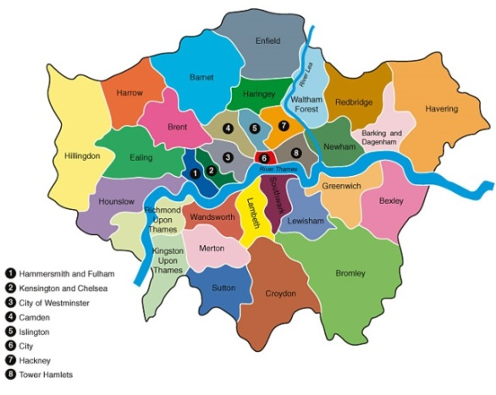
What happens next?
What happens next?
Co-ordinated admissions
  the admissions process is co-ordinated by all 33 London boroughs, neighbouring boroughs and other home counties
  application lists are exchanged
  offer lists are drawn up
  offer lists are exchanged.

Slide 25
What happens next?
What happens next?
How will places be allocated?
  if the school is oversubscribed, the published oversubscription criteria will be applied to decide who can be offered a place
  each school listed on the application form will be considered against the individual school’s oversubscription criteria
  your order of school preference is not passed to the individual schools.

Slide 26
Offers
Will I be offered more than one school place?
  Where the applicant qualifies for a place at more than one school, a place will be offered at the school that was ranked higher on the application form
  any lower preferences will be withdrawn and offered to other children
  no child will be offered more than one school.

Slide 27
Offers
When will I hear?
  National Offer Day is Thursday 16 April 2026
  Outcome emails will be sent to all applicants in the evening of 16 April
  applicants who are not offered their first choice will be given further information about waiting lists and appeals in their offer letters

Slide 28

Offers
Accepting offers
  click on the ‘Reply’ button at the bottom of the offer email notification and log into your eAdmissions account and submit your response
  places must be accepted by 30 April 2026

Slide 29

No offer
What happens if I don’t get any of my preference schools?
  where possible your child will be allocated an alternative school
  this will normally be the nearest school with a vacancy
  remain on the waiting lists
  appeal for a place

Slide 30

Appeals
Appeals
every parent has the right of appeal
appeals are heard by an independent panel
you will have the opportunity to present your case in person

Slide 31
….however
……however
Reception class appeals are nearly always unsuccessful because….
infant class sizes must not exceed 30 children
infant class appeals are only successful if you can prove that the local authority or the school has made a mistake
or that
the decision not to offer a place was not rational or was outrageous in its defiance of logic

Slide 32
Starting school in 2026
Update for 2018
32
Notes:
32

