Slide 1
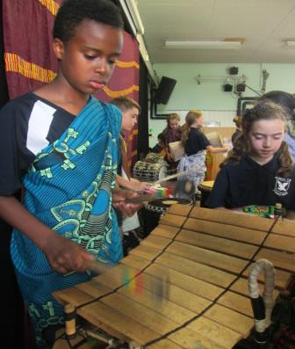
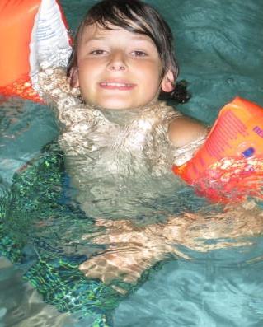
THE WIDER SCHOOL CURRICULUM AT ST. JOHN’S
‘BREADTH, DEPTH AND CREATIVITY’

Slide 2
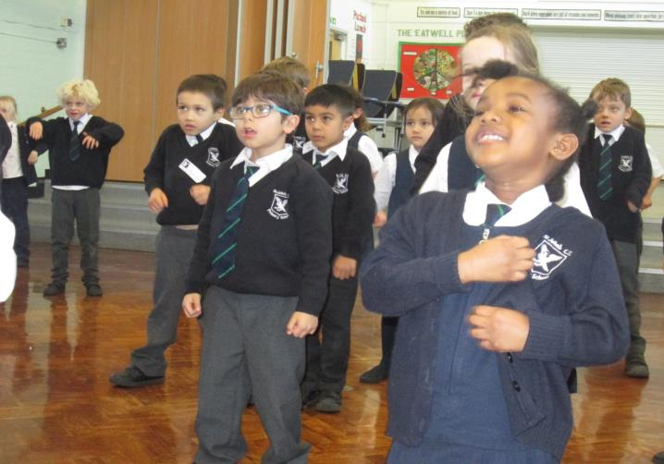
We want our children to be excited about their learning

Slide 3
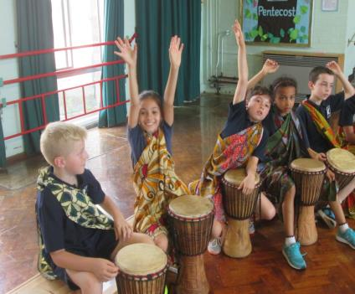
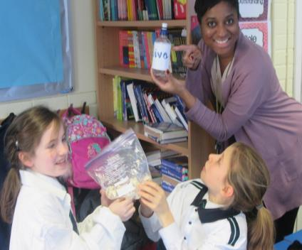
We want our curriculum to be fun, inspirational, challenging and exciting…
…for pupils …
…and the staff too!

Slide 4
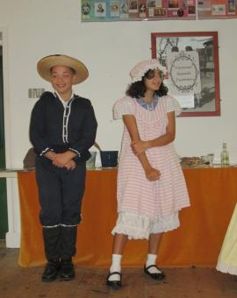
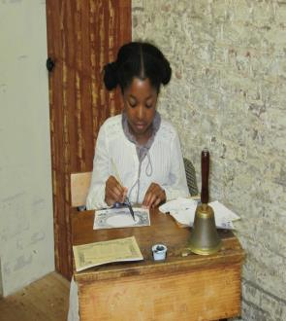
Our Topics Overview
Our trips and workshops are based on our topics
Y1 – Great Explorers, History /Travel & Transport – History / Local Area – Geography / Weather – Geography
Y2 – Kings & Queens – History / Great Fire of London – History / magical Maps – Geography / Our World – Geography
Y3 Tribal Tales – History / Flow – Geography / Tremors – Geography
Y4 – I am Warrior – History / Trader Raiders – History / Blue Abyss – Geography / Road Trip USA – Geography
Y5 – Off with her head – History / Ancient civilisations – History / Allotments – Geography
Y6 – Revolutions – History / Frozen Kingdom – Geography / Gallery Rebels - Art

Slide 5
So where do we go to learn in EYFS & KS1 when we are not in school?
In recent years we have regularly visited:
NURSERY – Butterfly World, Grovelands Park seasonal walks, Golders Hill Park, Paradise Park and The Arts Depot, Finchley.
RECEPTION – Science Museum, London Zoo, Veolia Water, Aldenham Country Park, The Arts Depot, Pets at Home, The London Aquarium, Natural History Museum, Discover Children’s Centre
Y1 – The RAF Museum, Southgate Fire Station, The Monument, London Canal Museum, The Ragged School, Finchley Synagogue, The Little Angel Theatre, Horniman Museum, Natural History Museum, London Transport Museum
Y2 – Hampton Court, Royal Gunpowder Mills, Aldenham Country Park, Highgate Woods, The Cutty Sark, Colchester Castle, London Aquarium, Lee Valley Environmental Centre, The Butterfly Farm, Fort Knebworth

Slide 6
So where do we go to learn in KS2 when we are not in school?
Y3 – Science Museum, Roman Verulamium, Maritime Museum, Celtic Harmony, the LSO Barbican, The Wallace Collection, The Royal Observatory, Nanak Darbar Gudhwara
Y4 – Hatfield House, Kew Gardens, Lego Land, London Fire Brigade Museum, Maritime Museum, Horniman Museum, Coppetts Wood nature Study
Y5 – The Golden Hinde, London Aquarium, Science Museum, Lee Valley Environmental Centre, Tower of London, Hyde Park Field Centre, National Car Museum, WW1 Memorial Garden, The London Buddhist Centre, St. Paul’s Cathedral, Cornwall (Y5 school journey)
Y6 – Junior Citizen, Henry Moore Museum, Imperial War Museum, Westminster Abbey, The Palace of Westminster, Science Museum, The National Gallery, Norfolk (Y6 school journey), St. James’ Church Christmas experience

Slide 7

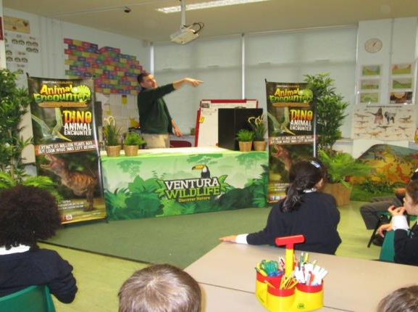
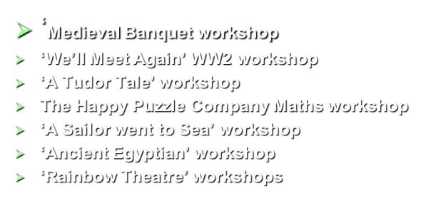

Slide 8
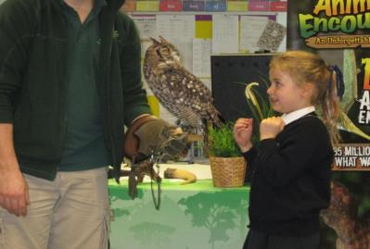
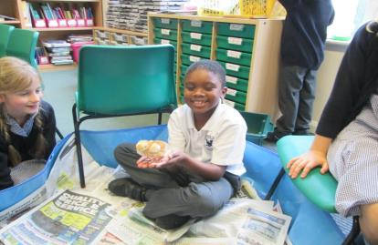
Blunderbus Theatre workshops
Young Shakespeare workshops
Junk Orchestra workshops
Design Technology workshops
Freshwater Theatre workshops
Billingsgate Market workshop
Play in a Day workshop
Roald Dahl workshop

Slide 9
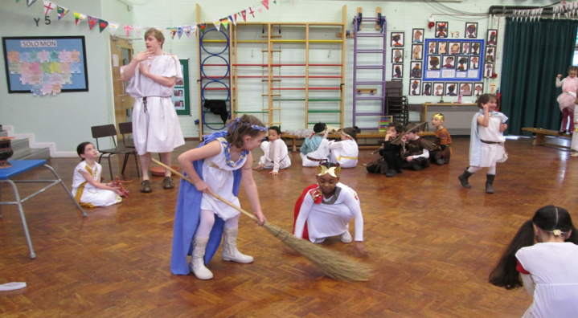
PARENTS – Voluntary Contribution of £15 per child per term
THE PTFA - £3,500 per year
FRIERN BARNET EDUCATION TRUST - £5,000 per year
SCHOOL BUDGET - £5,000 per year
HOW DO WE FUND THESE WONDERFUL TRIPS AND WORKSHOPS?

Slide 10
Children who enjoy their learning and are encouraged to think creatively and independently become:
more inquisitive and interested in discovering things for themselves
more open to new ideas
keen to work with others to explore ideas and solve problems

Slide 11
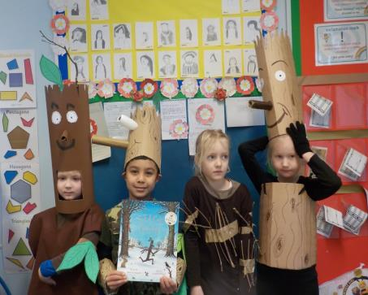
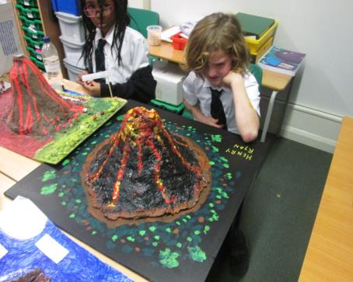
Where does exciting learning take place?
In the classroom..
..& with projects for homework

Slide 12
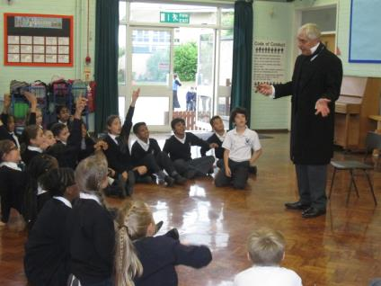
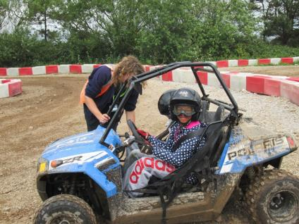
Where does exciting learning take place?
At school with ‘experts’
And beyond the classroom…with experts

Slide 13
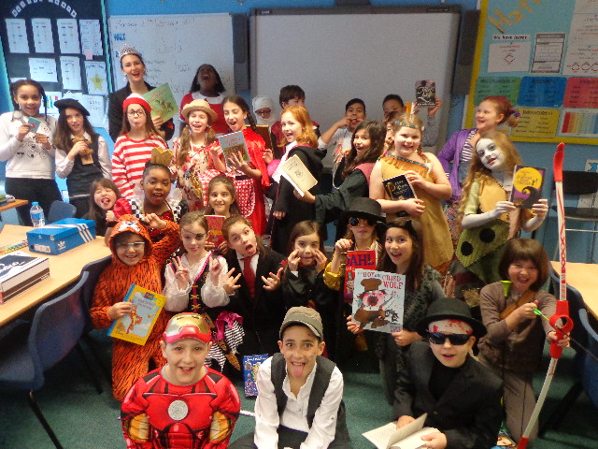
Learning at school
World Book Day

Slide 14
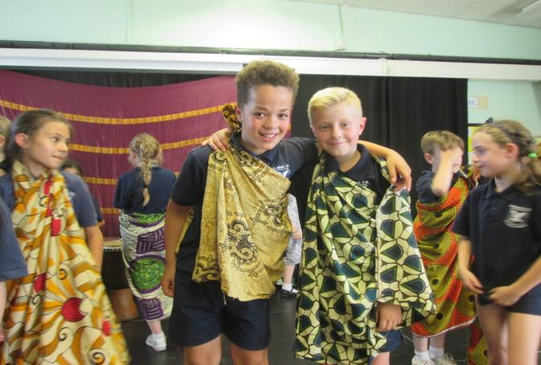
Learning at school
African Story Telling workshop

Slide 15
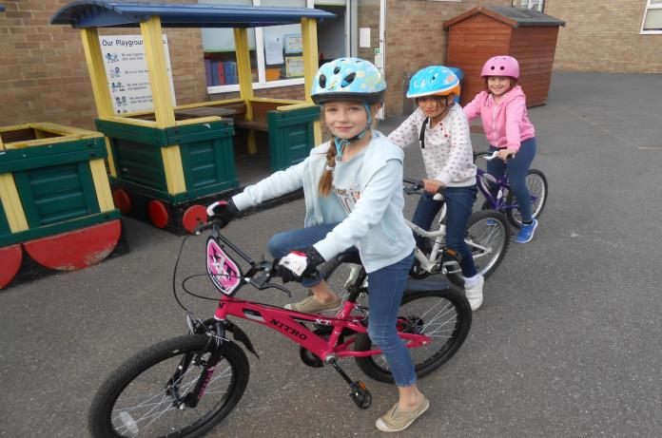
Learning at school
Learning how to be safe on our bikes

Slide 16
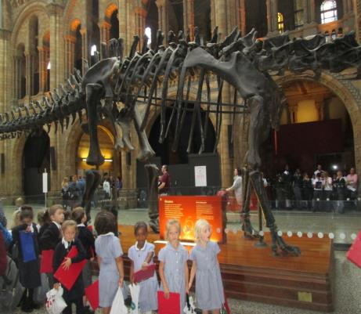
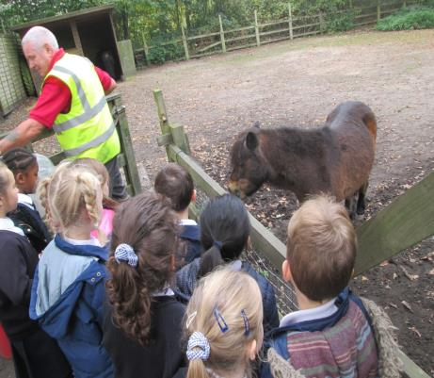
Learning beyond the classroom

Slide 17
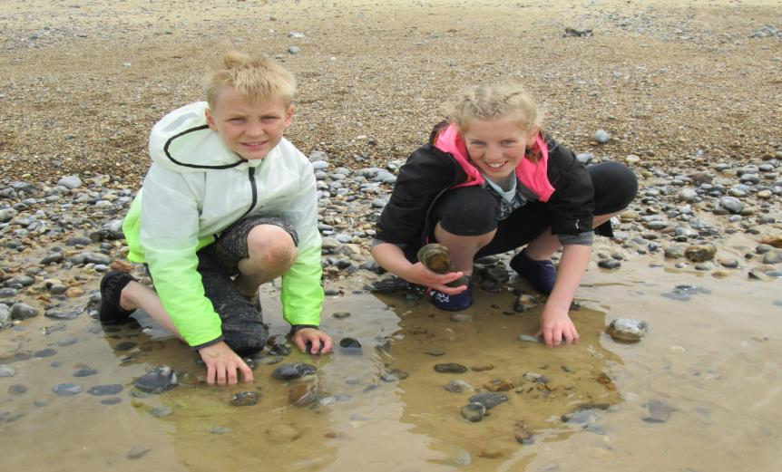
Learning beyond the classroom

Slide 18
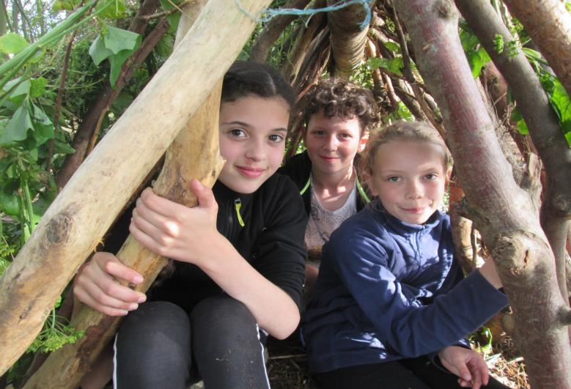
Learning beyond the classroom

Slide 19
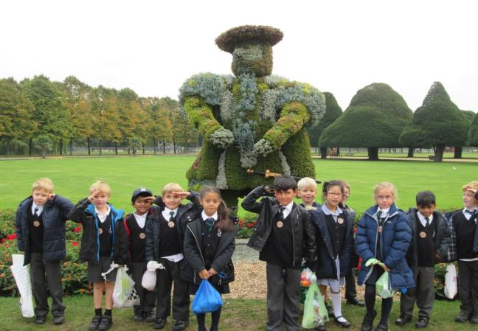
We love to take our learning out of school. London and the Home Counties have so much to offer, so we can and we do go everywhere…….
…. because we have 2 minibuses which we couldn’t have bought without the help of the PTFA and Friern Barnet Education Trust. THANK YOU!

Slide 20
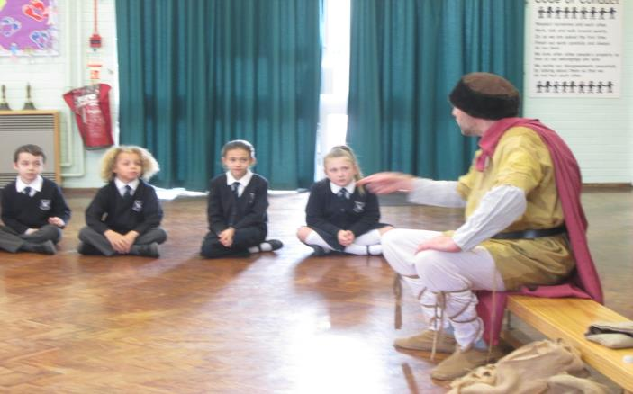
We like to learn from experts. If we don’t go to them we ask them to come to us.
We run workshops in school on all sorts of subjects – science, drama, maths, literacy, geography, history, environmental studies, music, art and technology to name just a few!

Slide 21
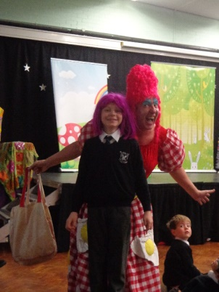
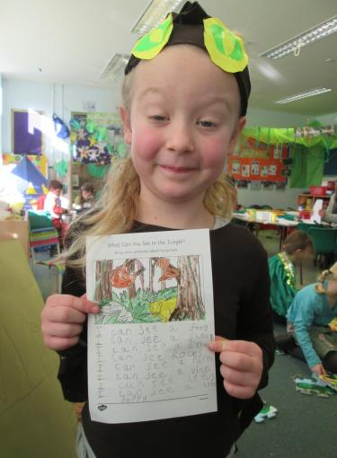
Learning should be fun.
Learning at St. John’s is FUN!

Slide 22
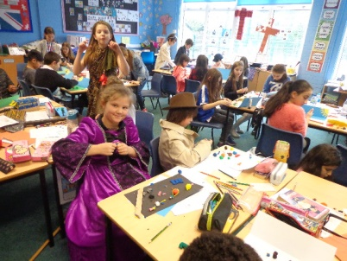

Slide 23
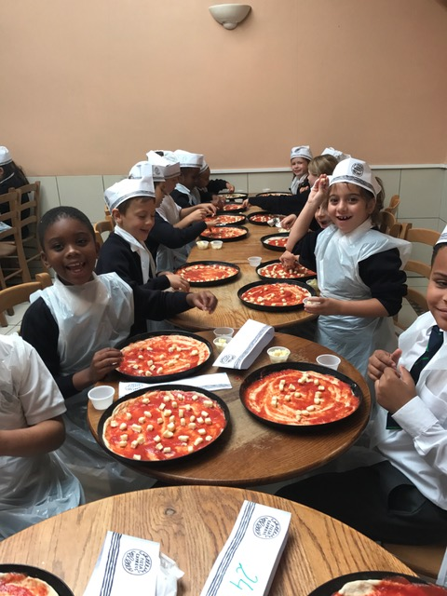

Slide 24


Slide 25
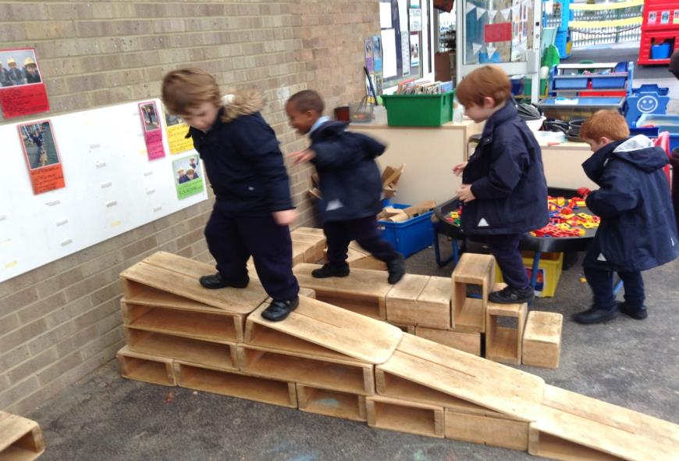

Slide 26
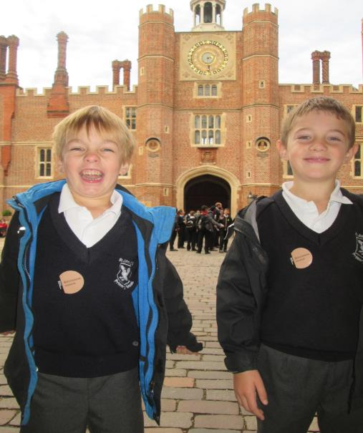

Slide 27
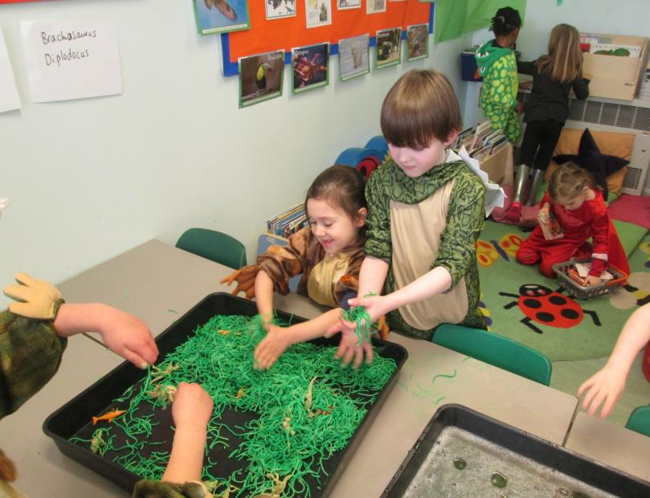

Slide 28
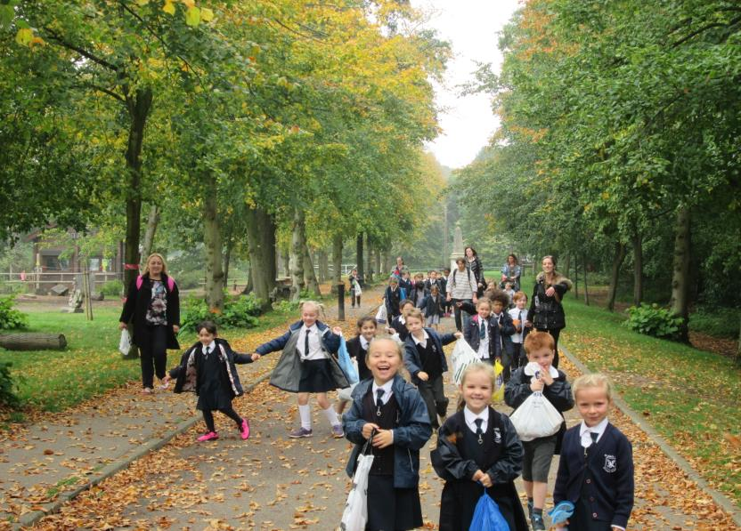

Slide 29
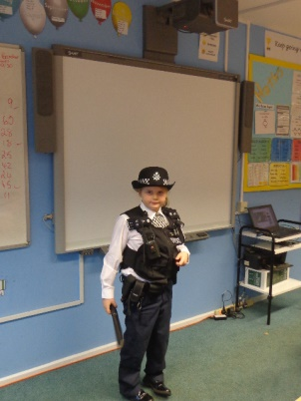
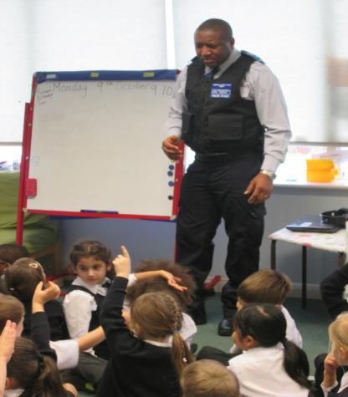
‘Spot the difference!’

Slide 30
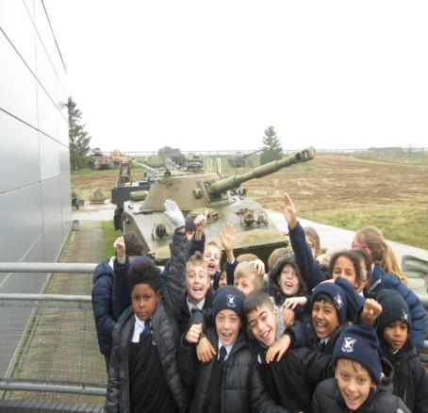
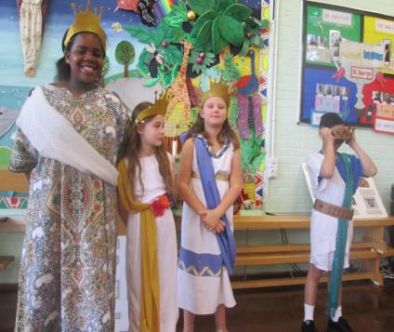
Ancient Greece workshop
A trip to the Imperial War Museum, Duxford

Slide 31
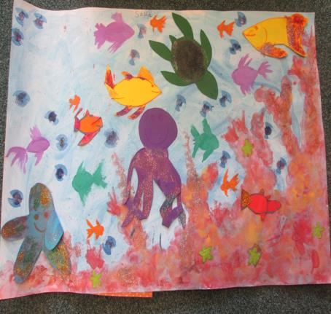
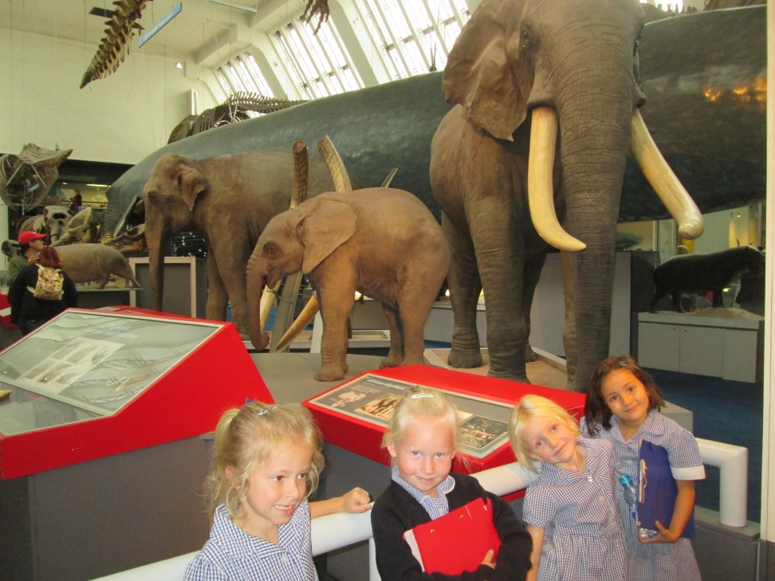
Be inspired………….

Slide 32
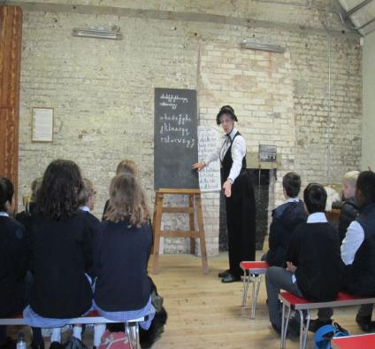
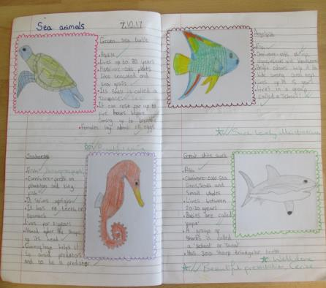
And love to learn!

